Slide 1
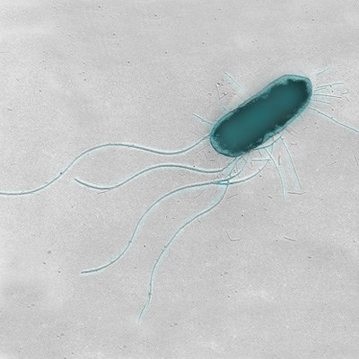
Induced expression of FLIC
In non-motile bacteria
Cameron Harper
Tyler Jones

Slide 2
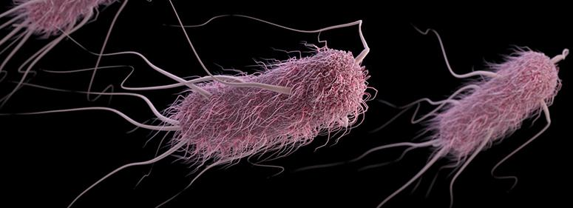
E Coli

Slide 3
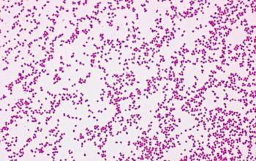
Neisseria Subflavia

Slide 4
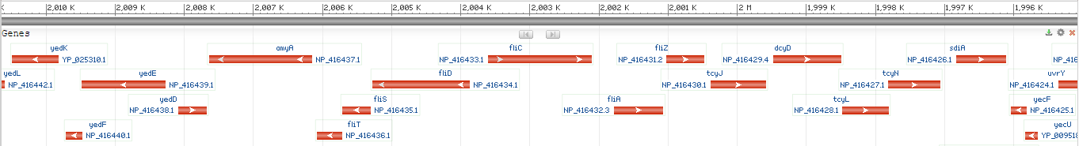
FLIC Gene

Slide 5
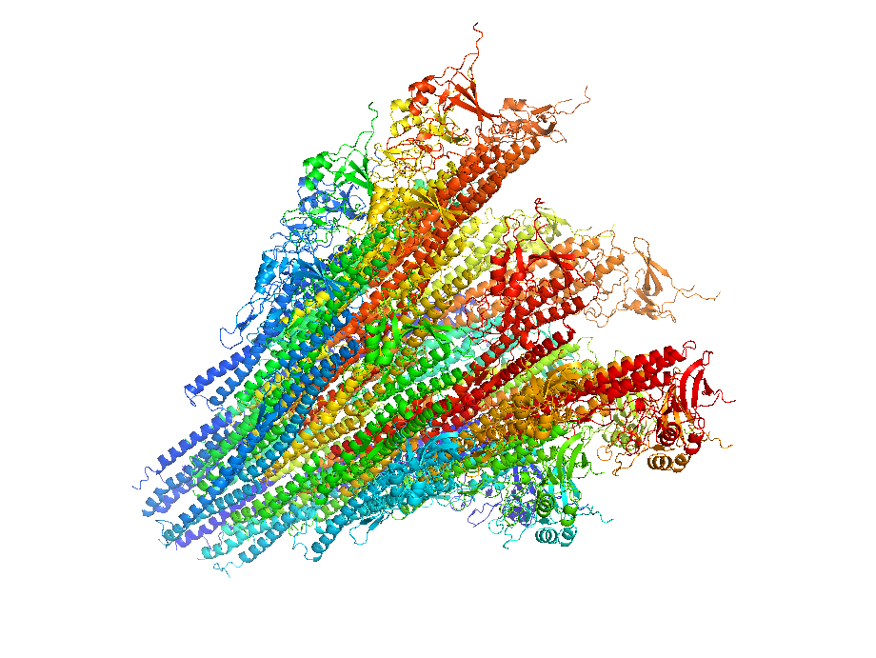
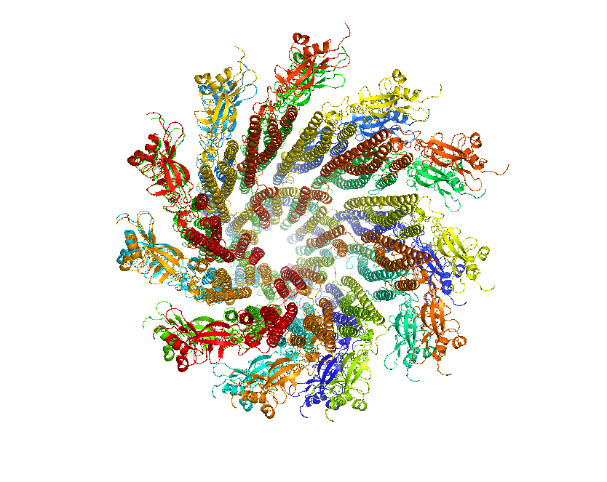
FLIC Protein
flagellar filament structural protein

Slide 6
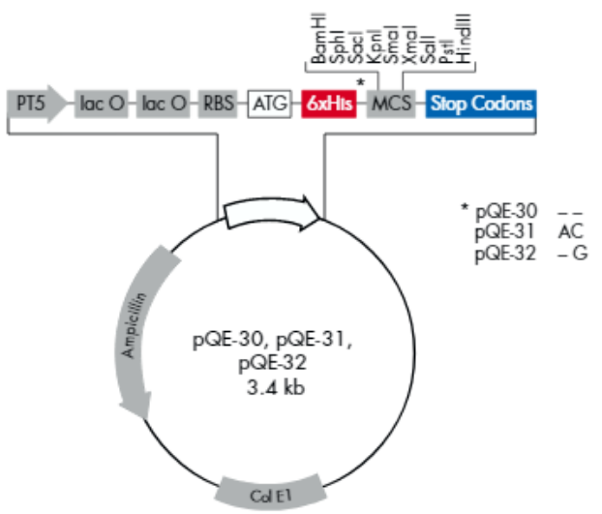
Design Primers
Forward
A*GAT CTG ACC TGA CCC GAC TCC CA
BglII Restriction site
Reverse
GCC GTC AGT CTC AGT TAT CAA GCT*T
HindIII Restriction site

Slide 7
Waiting for Primers
Things we could have done while waiting for primers…
Go to Hawaii
Watch all of the Harry Potter and Lord of the Rings movies
Invested time into watching march madness
Ordered primers and received them
Finished our project with week to spare
Done another IRP
Learned a new talent
Built a full size lego millennium falcon

Slide 8
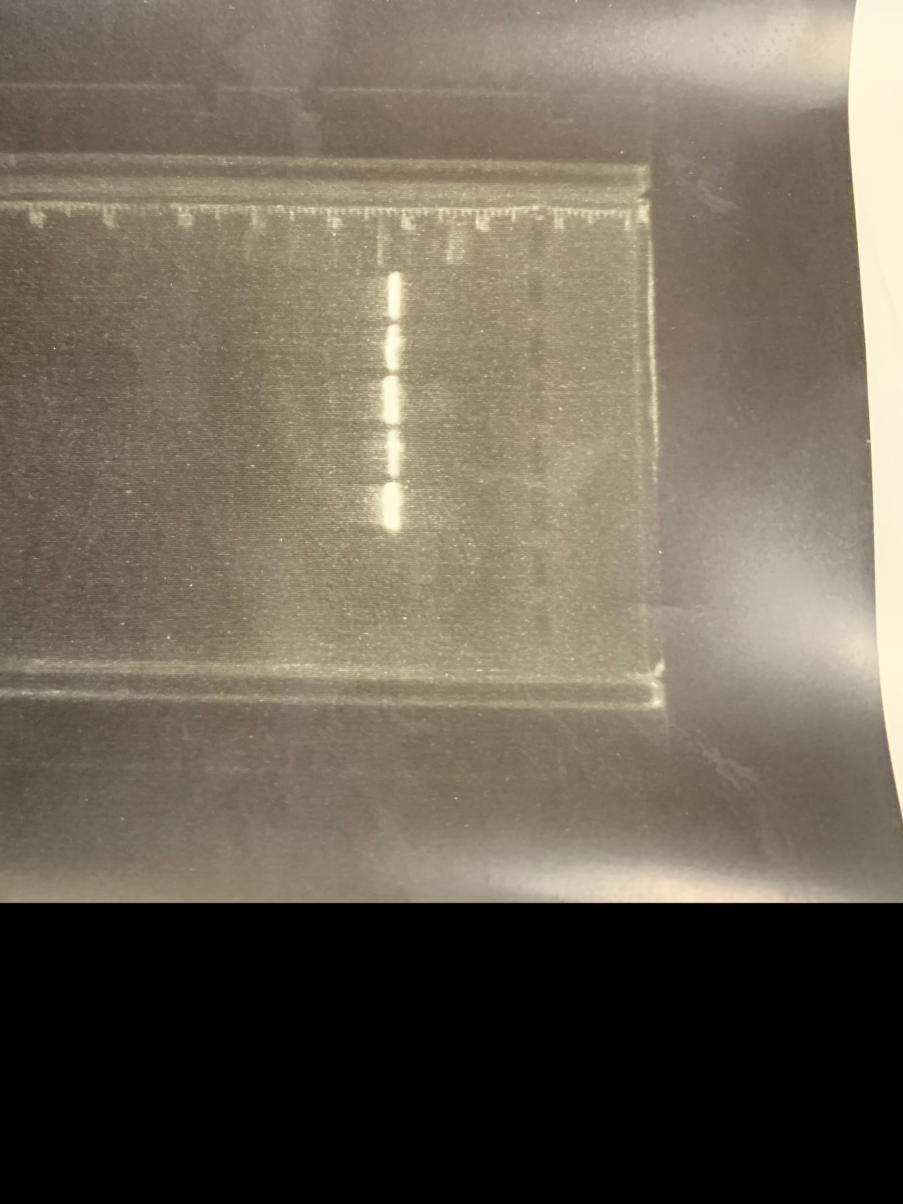
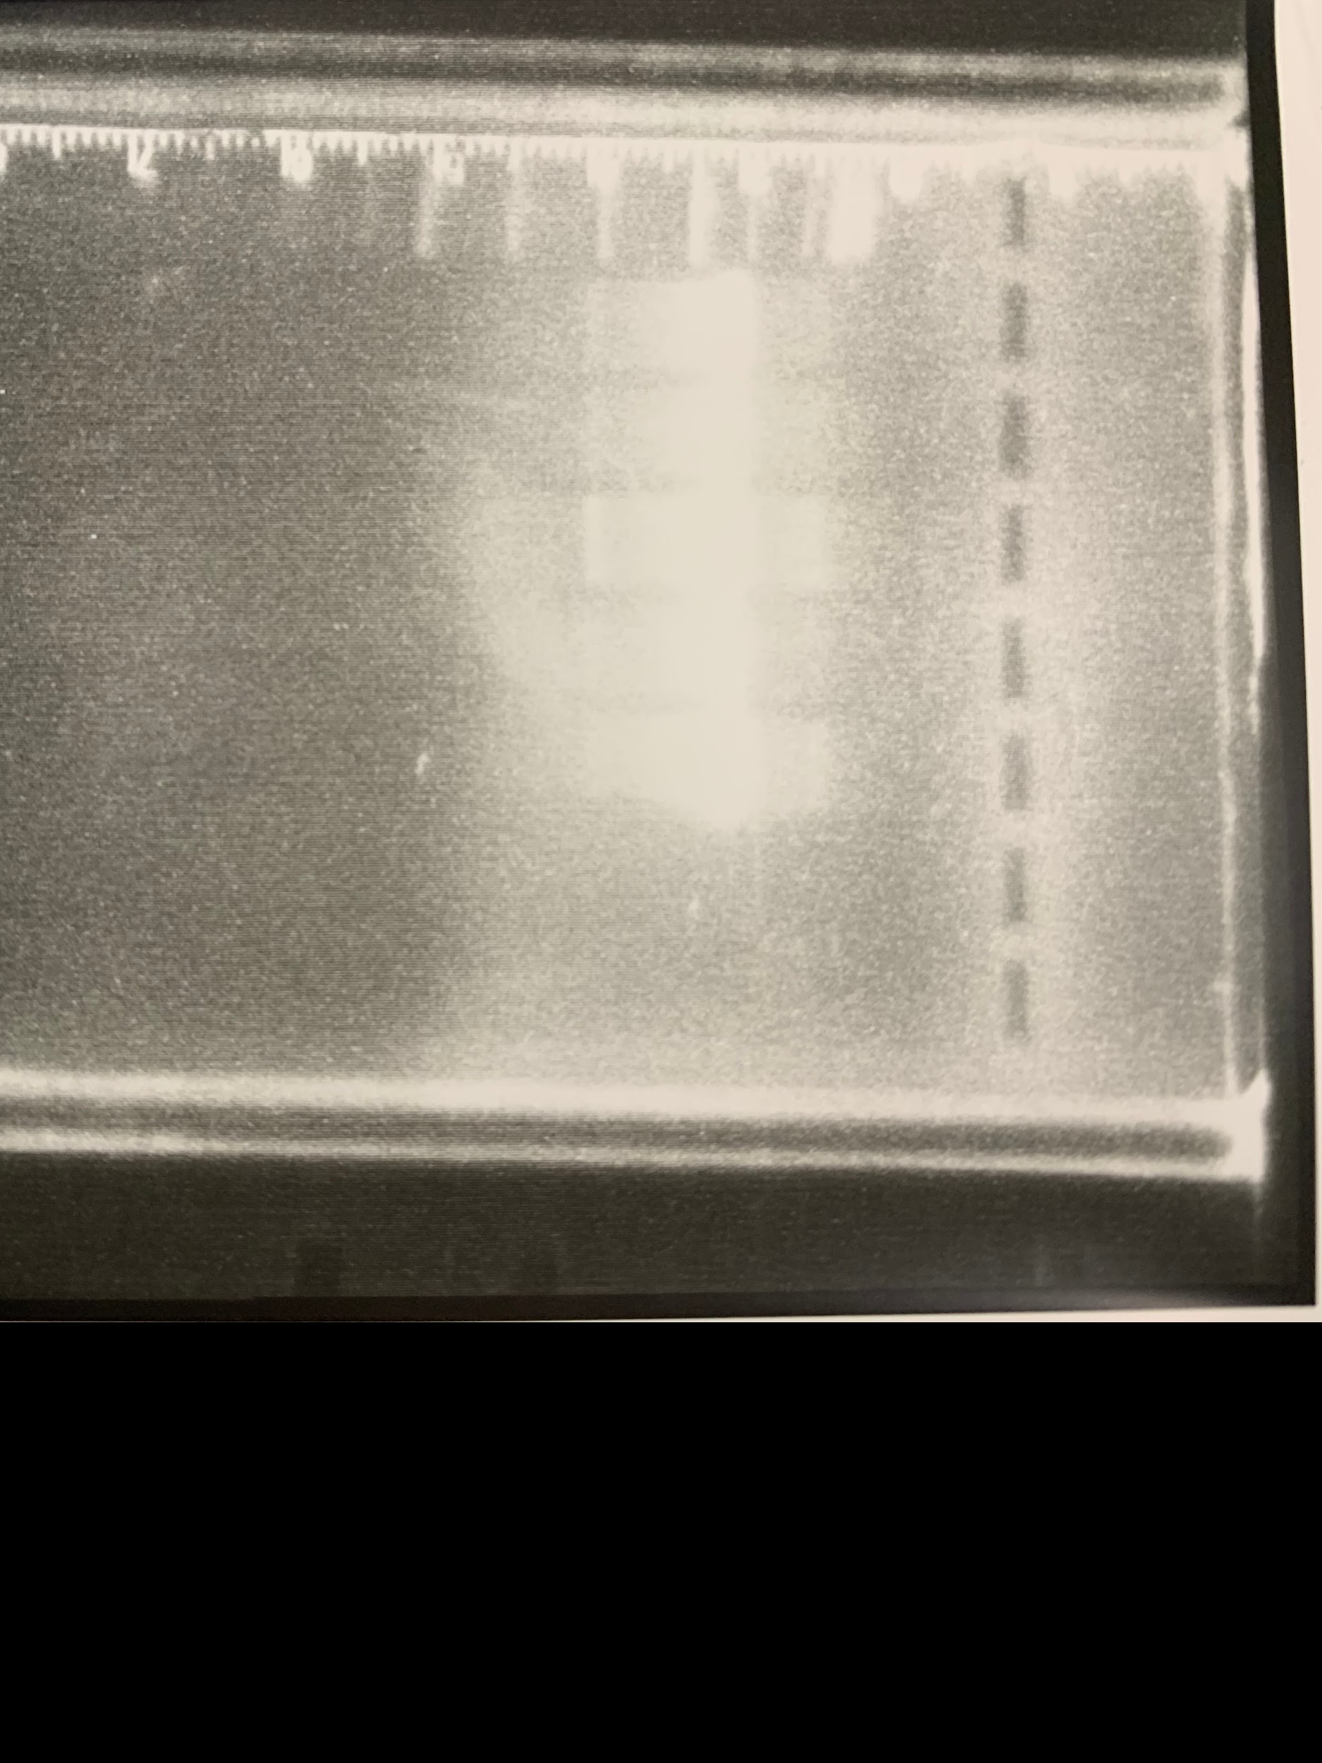
PCR

Slide 9
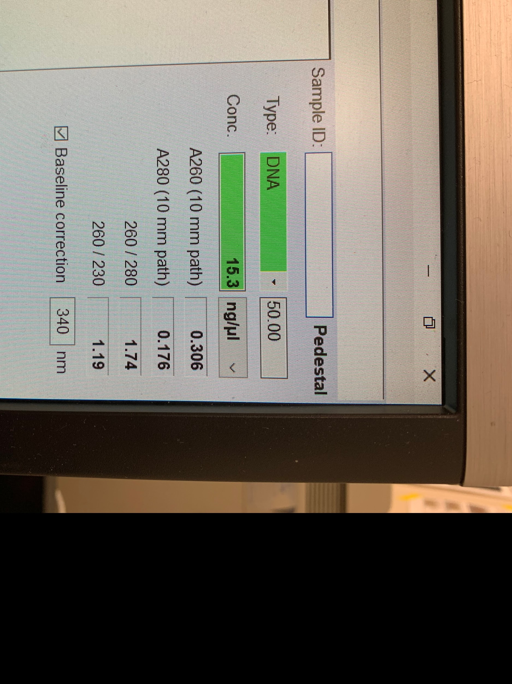
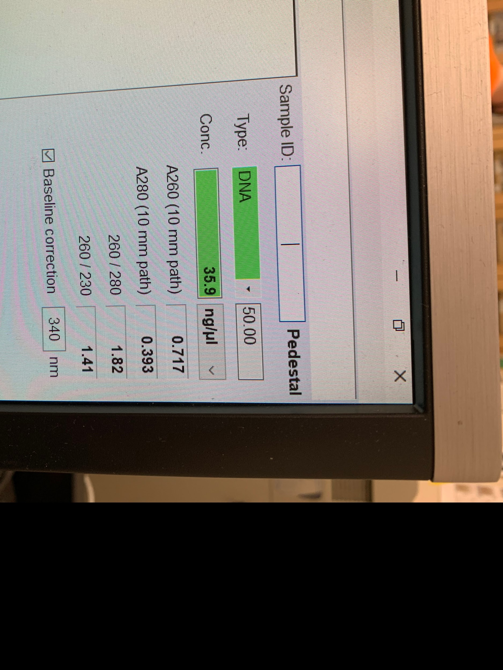
Nanodrop
Plasmid
PCR Product

Slide 10
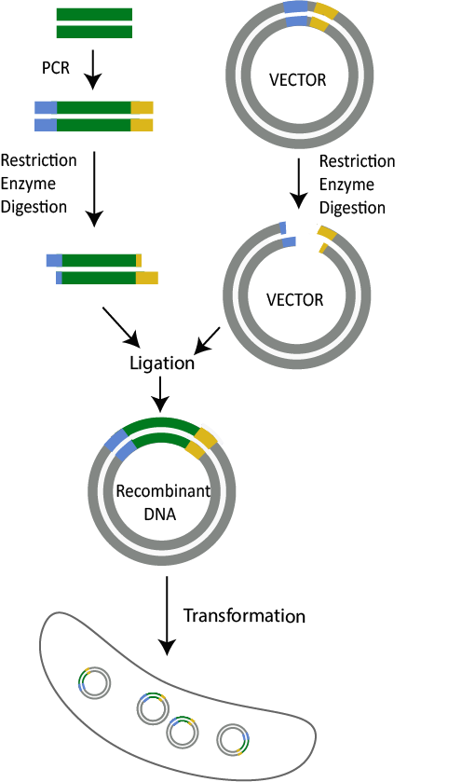
Restriction Digest & Ligation

Slide 11
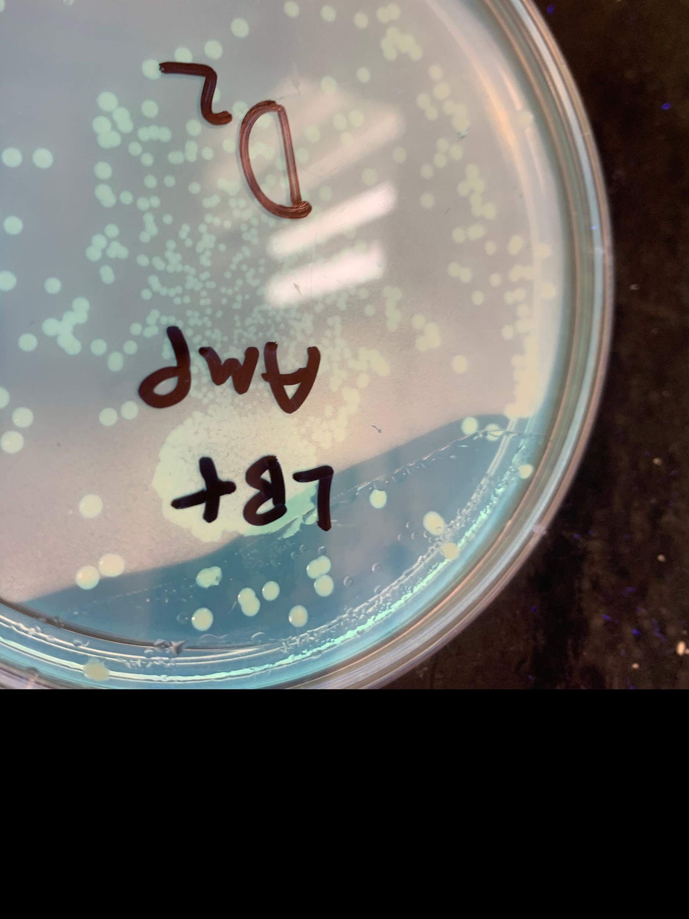
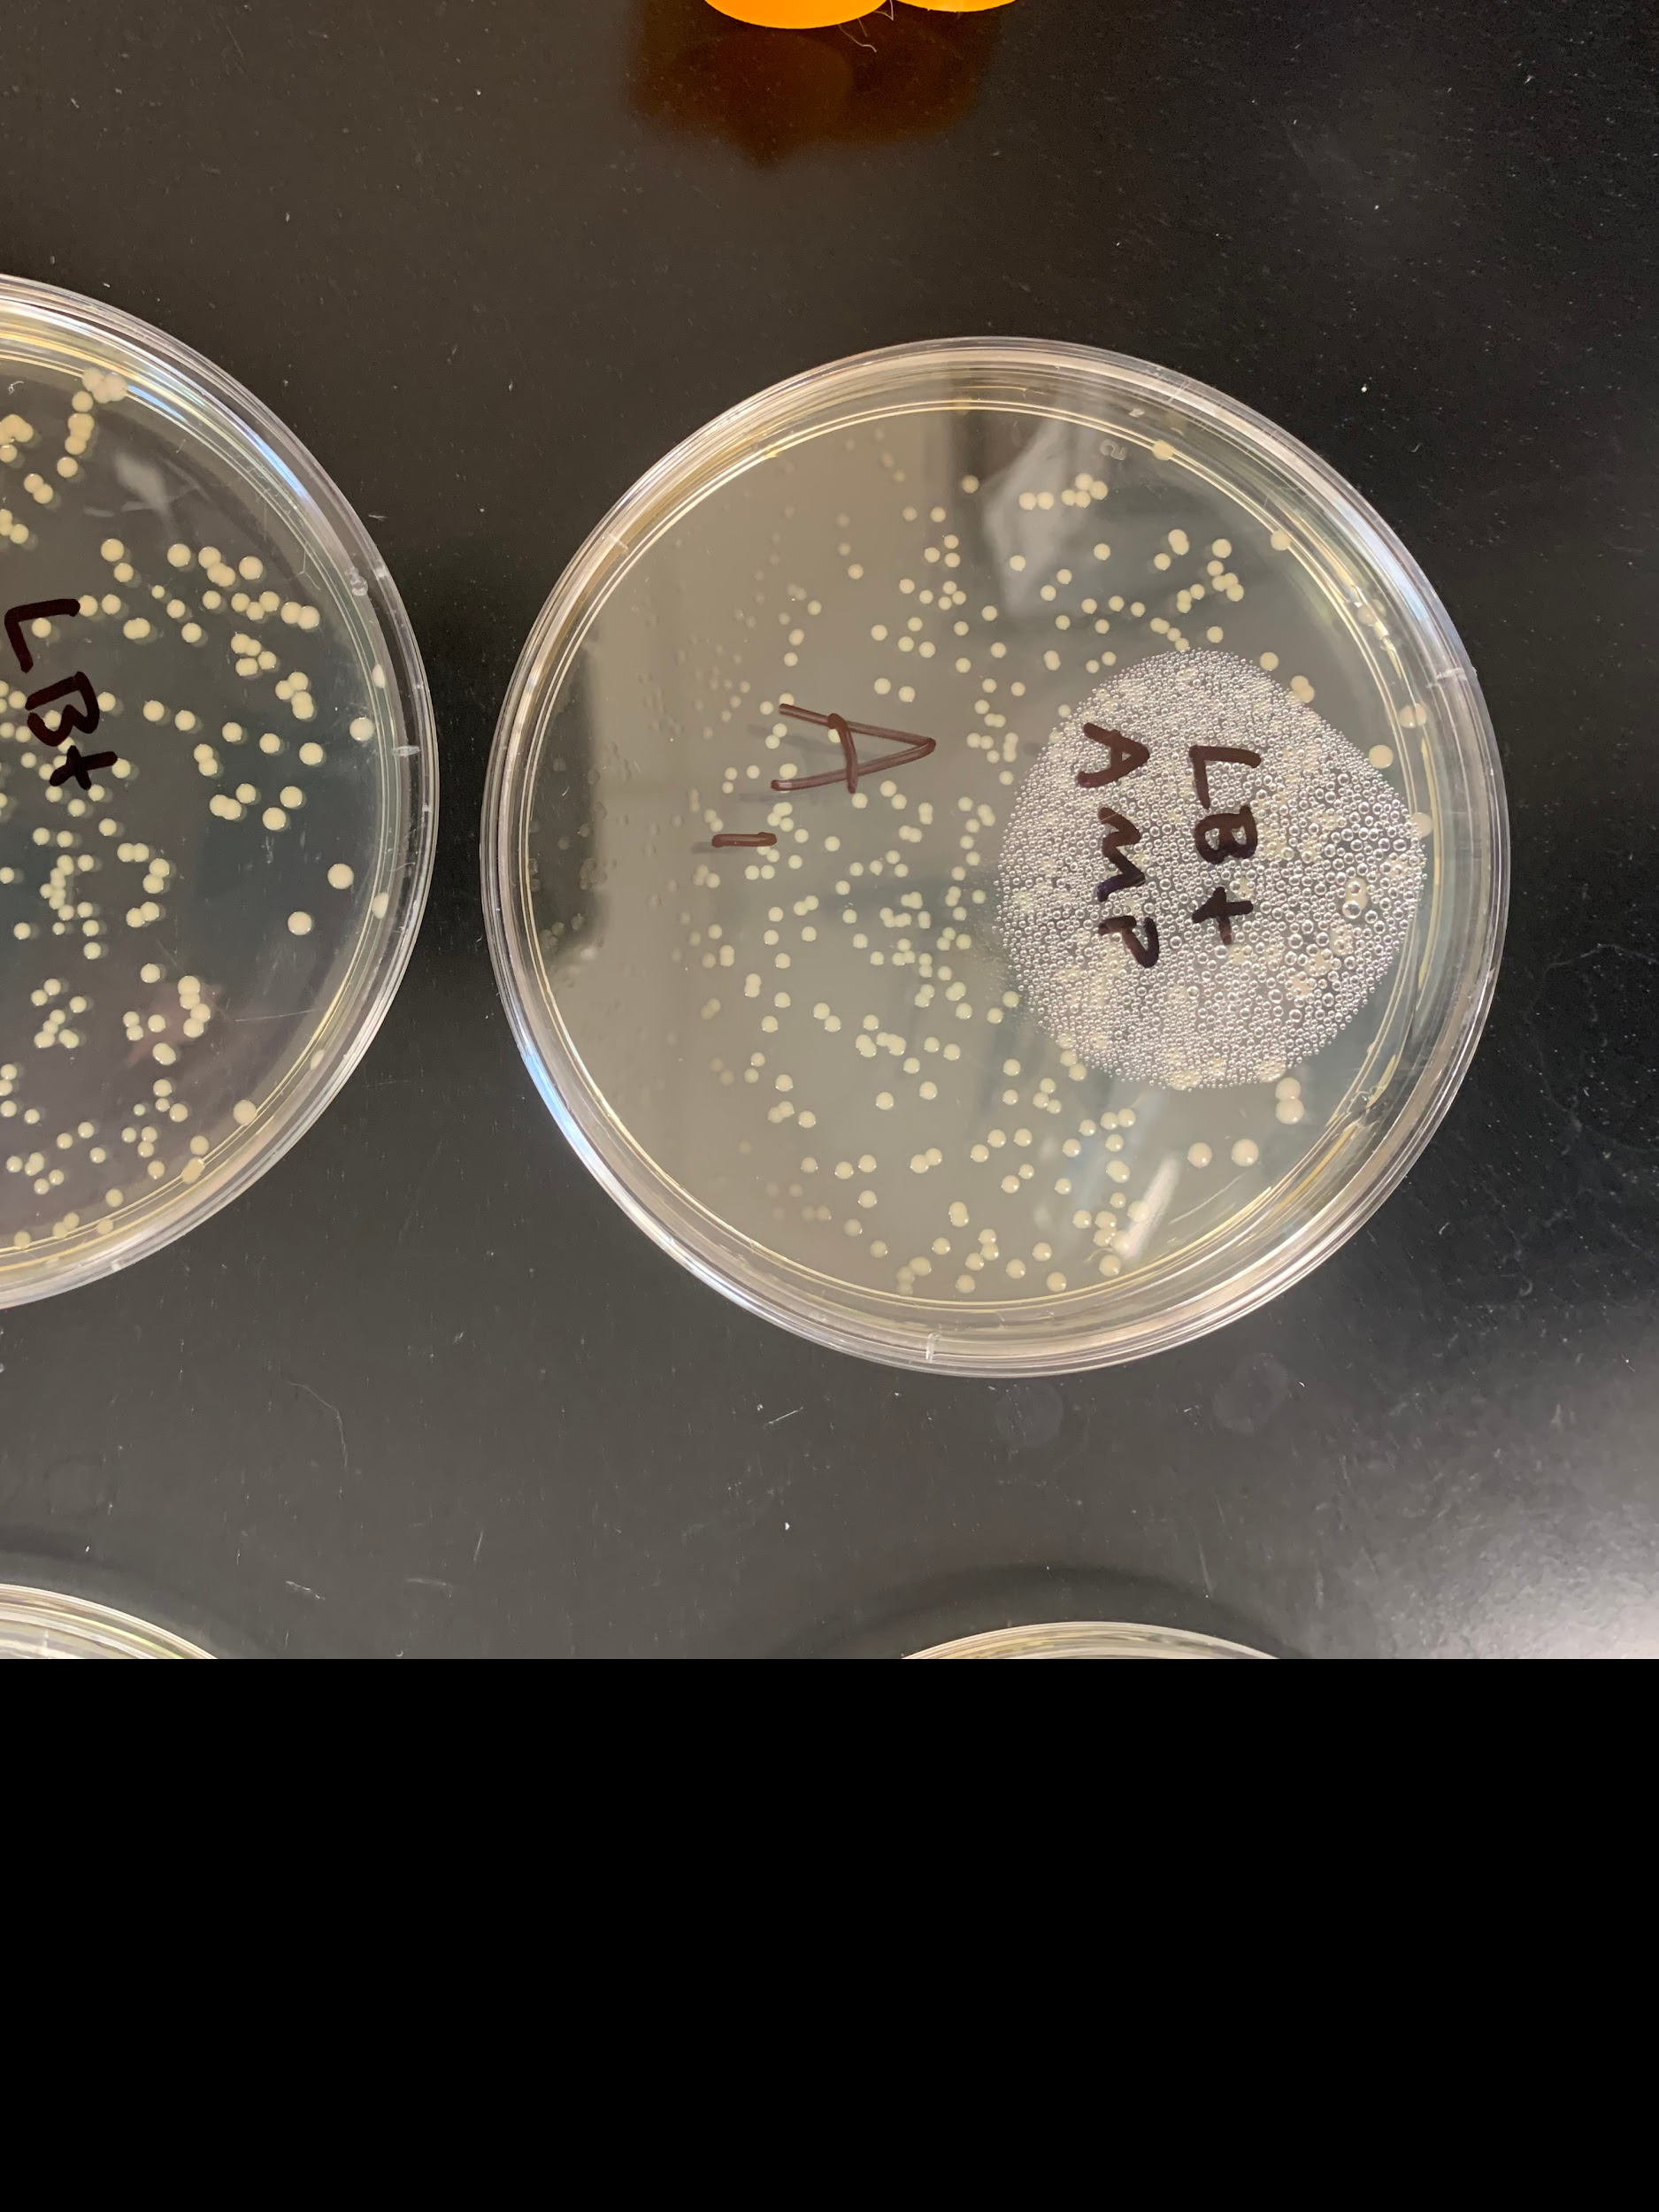

Transformation

Slide 12
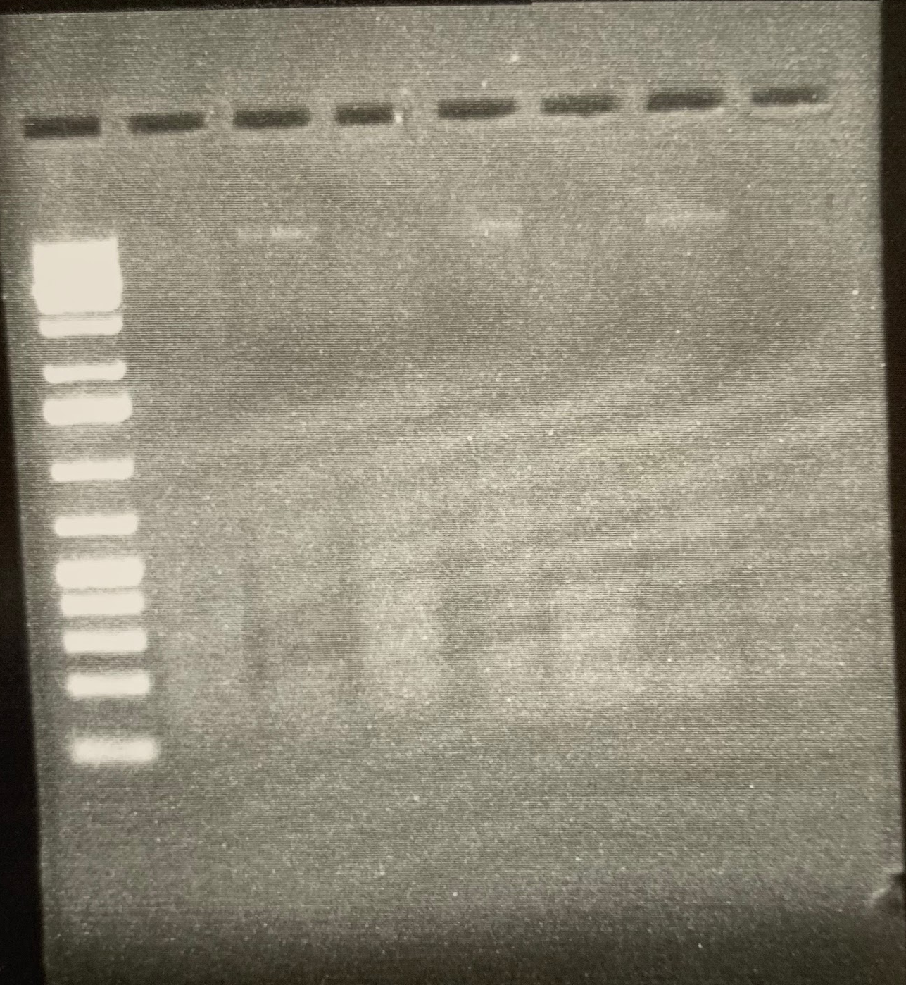
Verification Digest
Not very good but a reasonable explanation

Slide 13
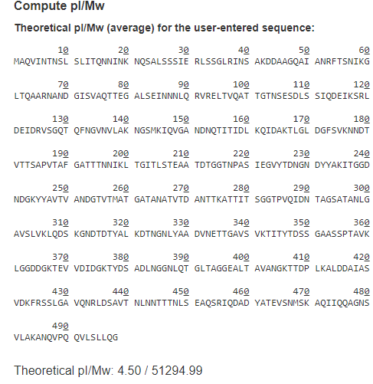
Sequence and MW of flagellin

Slide 14
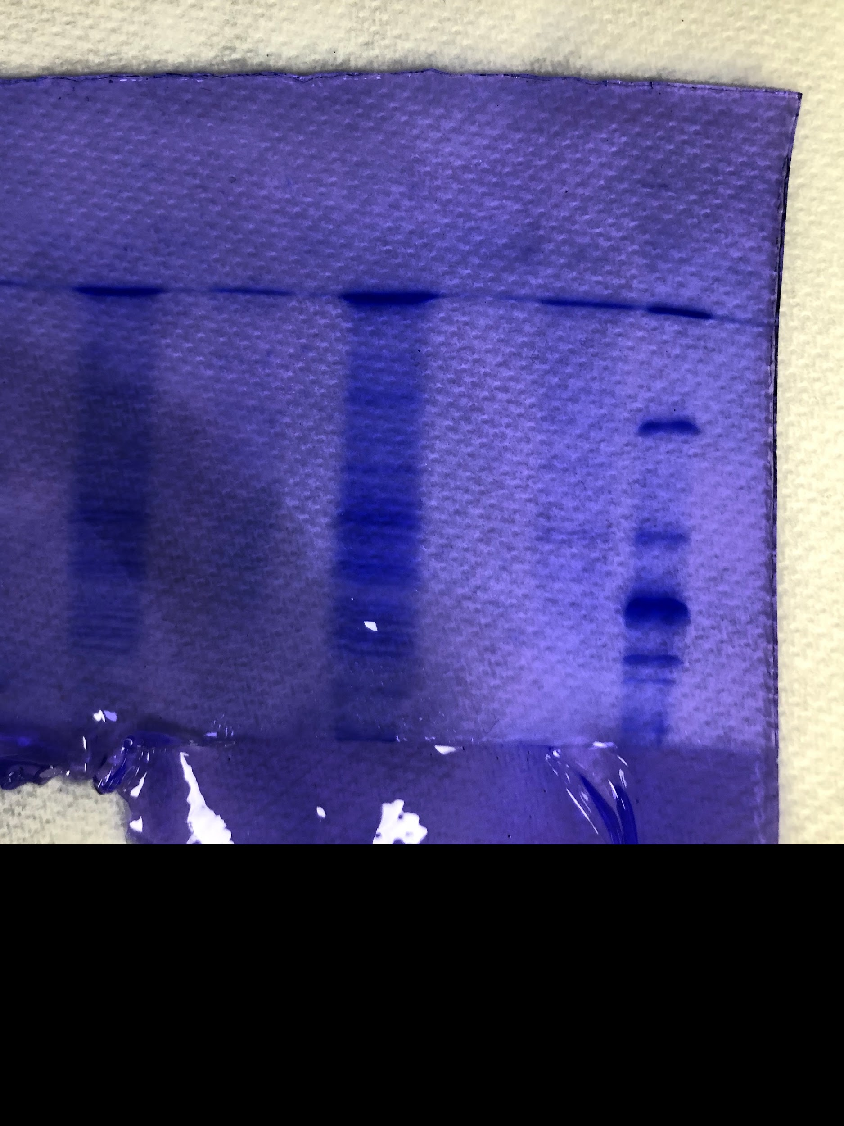
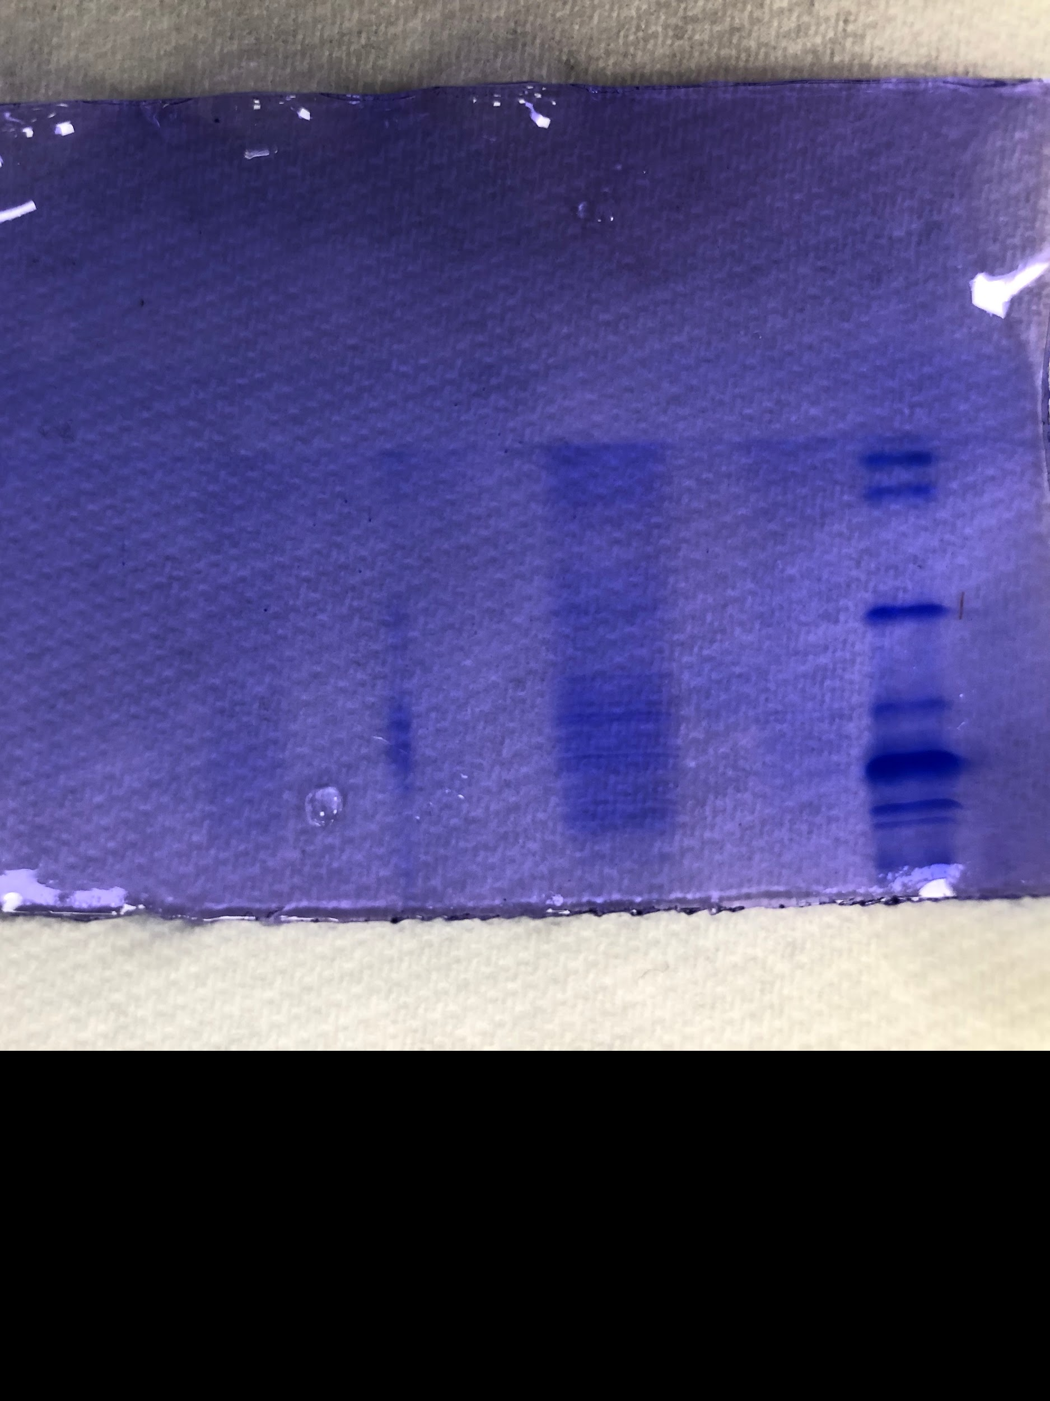
SDS Page Attempt 1
A sad excuse for a gel but a great ladder

Slide 15
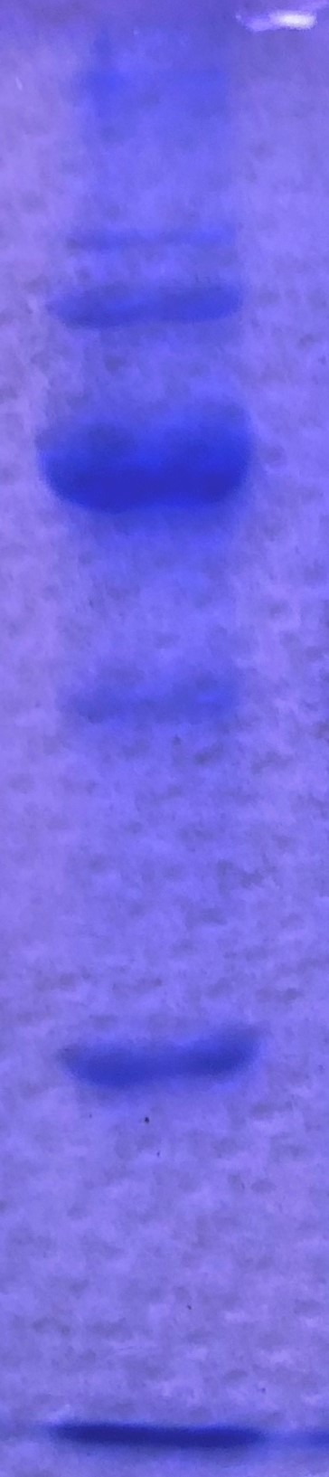
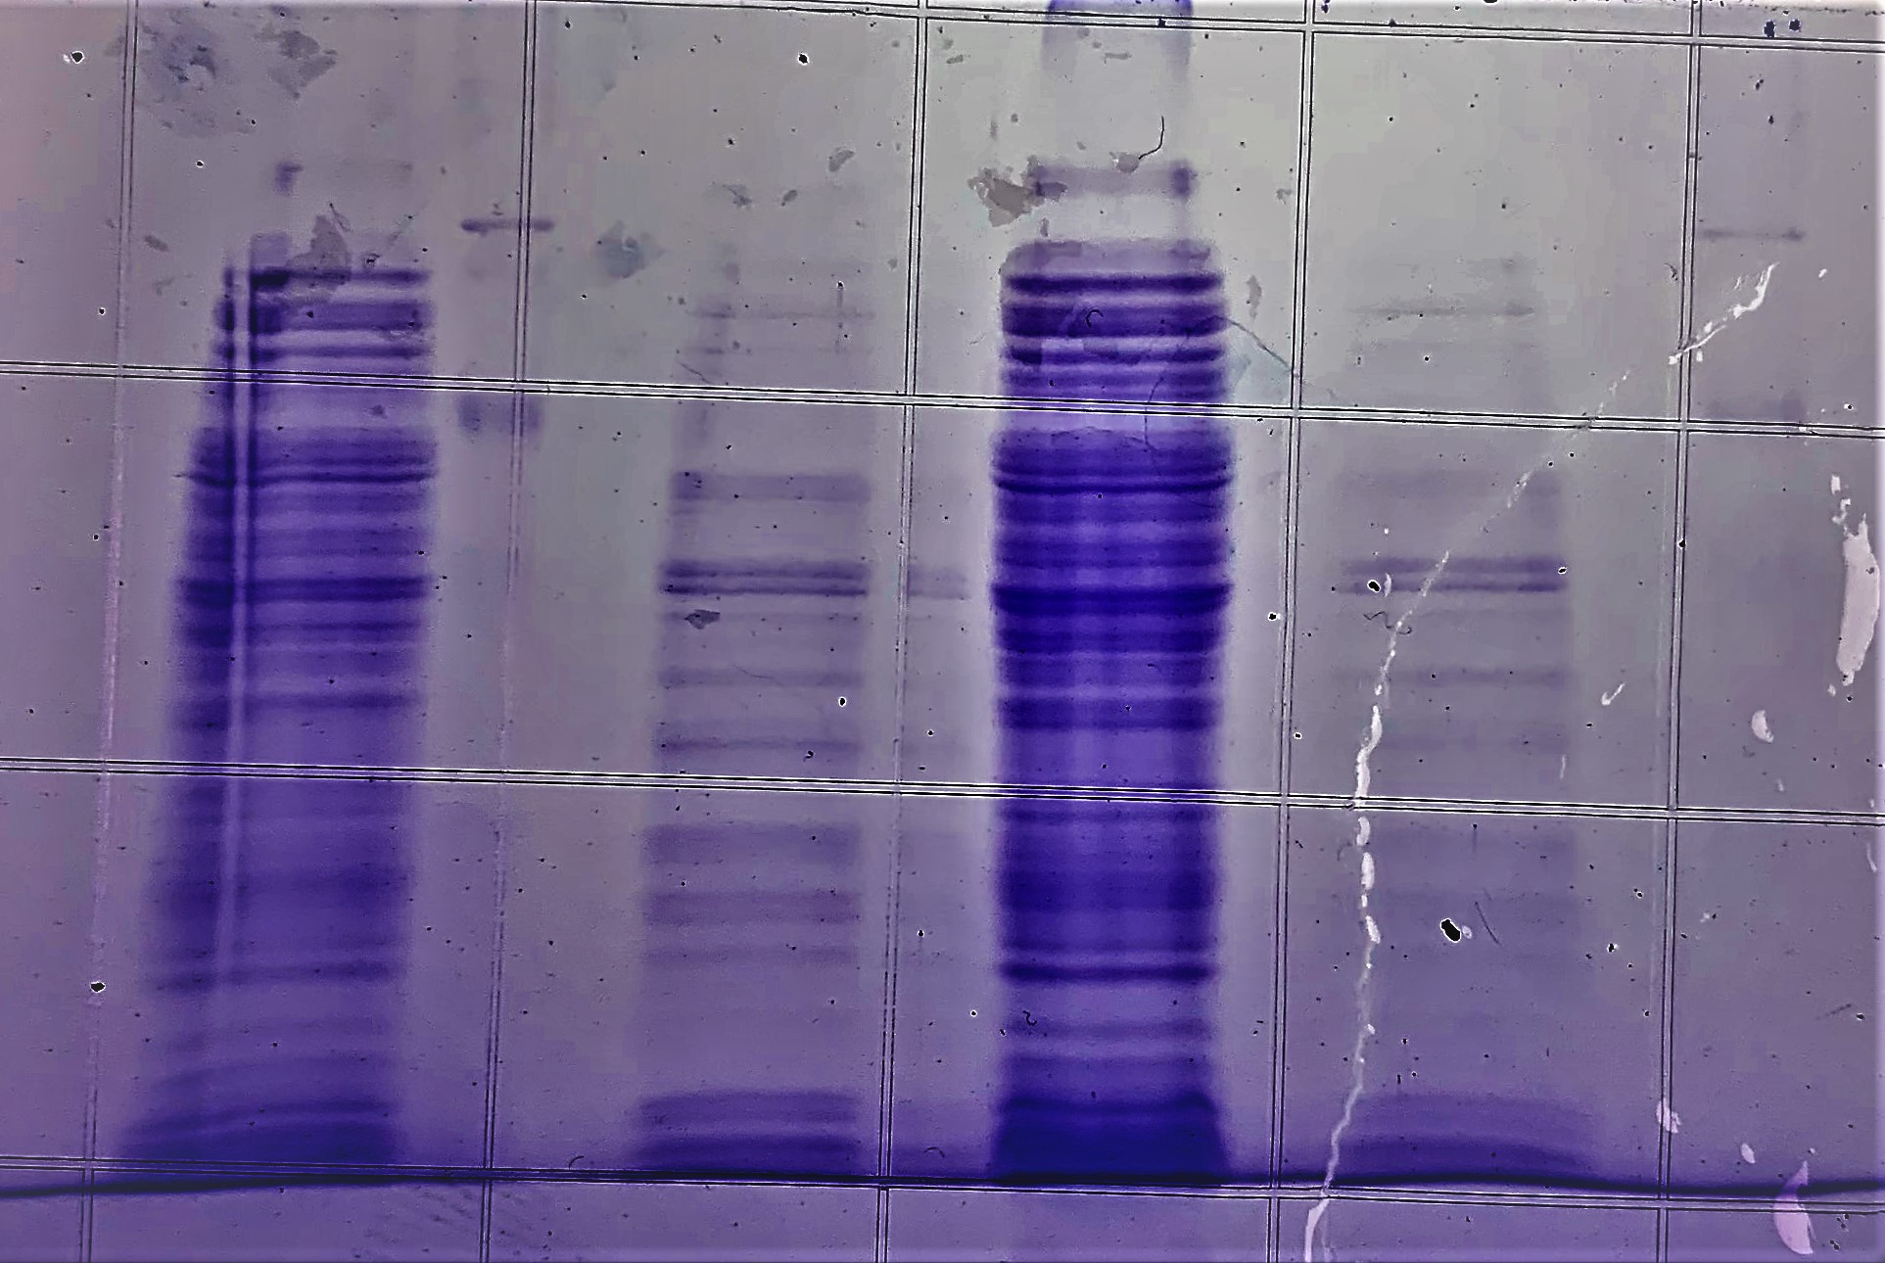
SDS Page Attempt 2
WT N. Subflava
Transformed N. Subflava
Bovine Albumin (67 kd)
Estimated 51.3 Kd (site of flagellin)
Ovalbumin (45 kd)

Slide 16
What we would do with more time and money
Order anti-flagllar filament structural protein antibodies and perform a western blot to confirm the presence of the specific protein we desired.
Continue transforming the rest of the flagella genes into the bacterium and try to express fully functioning flagellum.
Perform a flagellar stain to allow flagellum to strut their stuff
Kill all remaining bacteria to prevent another pandemic...

